Slide 1
Mold Yourself
-An interview practicing platform
Guided by: Sheera Shamsu
Date: 08-11-2024
Submitted by Nadiya Farook
Roll no: MCA23-144

Slide 2
Introduction
Mold yourself uses deep learning to assess a candidate's performance, including real-time emotion recognition from video via facial analysis. The system will use emotion recognition models trained on dataset FER2013 to detect and classify emotions in real time. The system includes user registration, login functionality, and stores interview histories for candidates.

Slide 3
Literature survey:
Sl.no
Title
Author
Algorithm / Accuracy
1
Frame-level Prediction of Facial Expressions, Valence, Arousal, and Action Units for Mobile Devices.
Savchenko
VGG16
Accuracy: 50%
2
Facial emotion detection and recognition.
Amit Pandey, Aman Gupta, Radhey Shyam
CNN
Accuracy: 66%
3
Facial expression recognition via ResNet-50
Bin Li, Dimas Lima
ResNet50V2
Accuracy: 58%

Slide 4
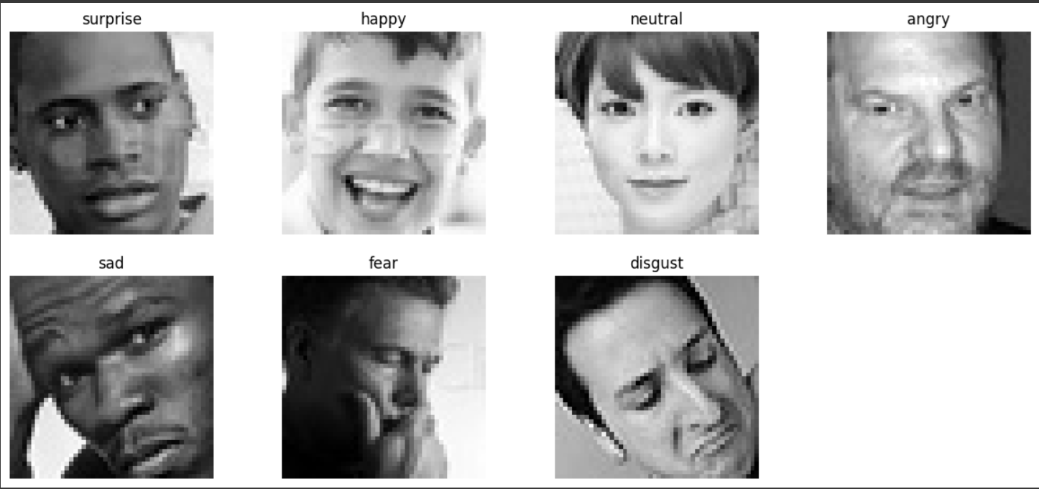
Dataset:
Name: https://www.kaggle.com/datasets/msambare/fer2013
Features:
Surprise
Happy
Neutral
Angry
Sad
Fear
Disgust
Total files: 35.9k

Slide 5
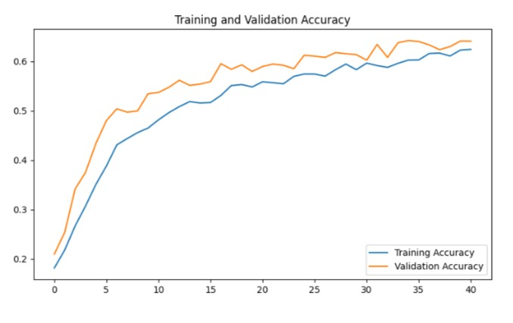
CNN model

Slide 6
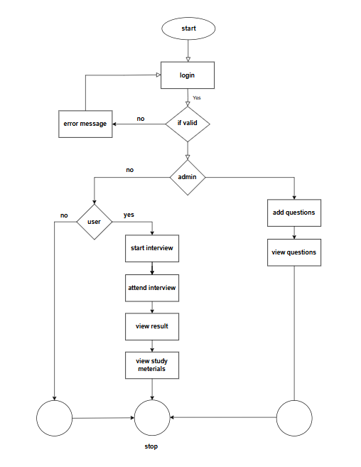
About the Flow Chart:
Users start by logging in, and if valid, they proceed based on their role.
Admins can add and view questions.
Regular users can start and attend interviews, view results, and access study materials, all leading to the end point, "stop."

Slide 7
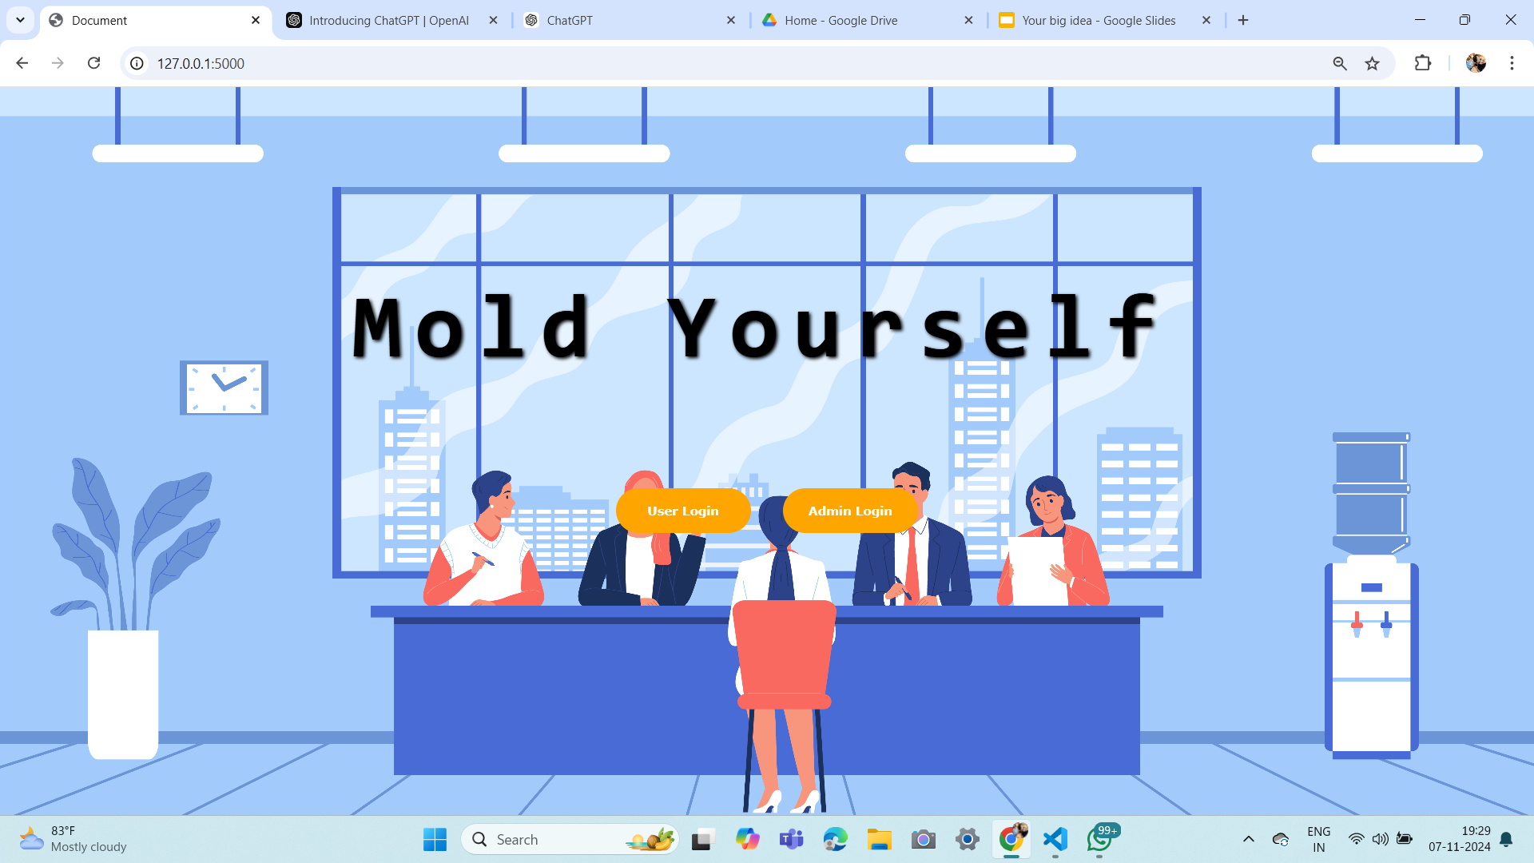
Front page

Slide 8

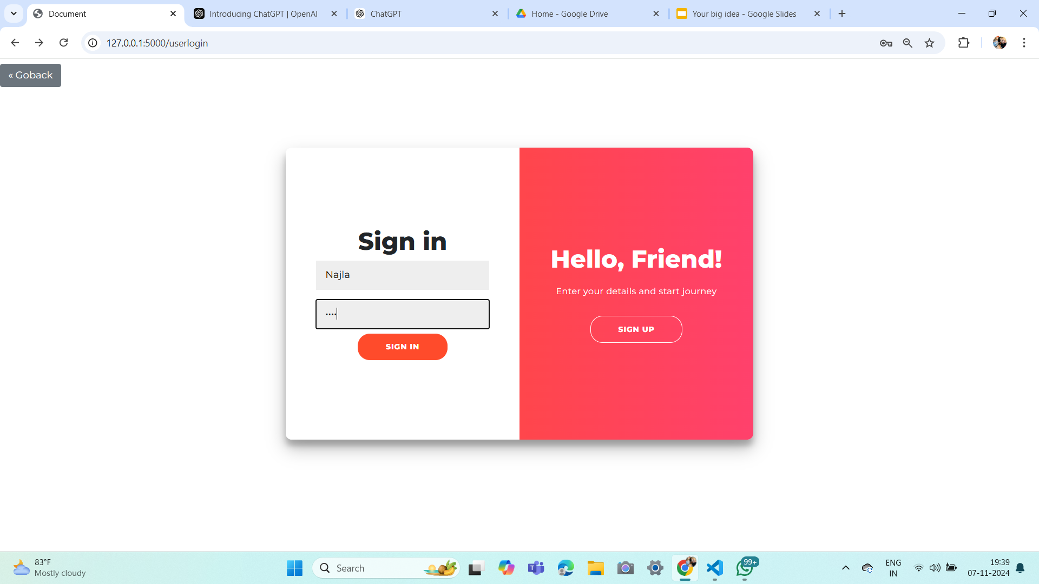
Login/Registration page

Slide 9
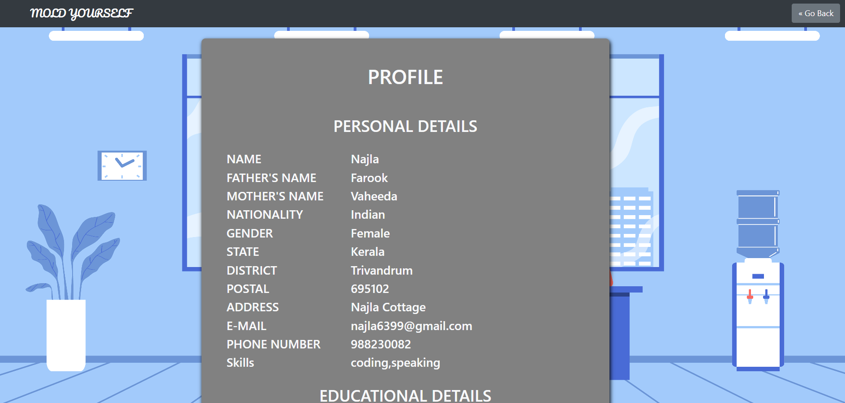
Profile page:

Slide 10
Conclusion:
The Mold Yourself project serves as a transformative platform, empowering individuals to shape their skills and confidence through personalized mock interviews. By simulating real interview experiences, tracking progress, and providing valuable feedback, the project helps users refine their responses, manage emotions, and gain insights into their strengths and areas for improvement. Ultimately, it fosters a supportive environment that prepares candidates to face real interviews with increased readiness, boosting their chances of success in their career journeys.

Slide 11
THANK YOU

